Slide 1




About Speaker
Marcus Brito
Senior DevOps Engineer with over 15 years of experience. I have evolved from a SysAdmin and Linux Specialist to an expert in Kubernetes (CKA/CKAD) and Cloud Architecture. I help organizations scale on Azure, AWS, and OCI using Terraform and GitOps. Currently, I work at Globant and assist in organizing DevOps Days Brasília.
@marcusbrito
mcabrito
$ falco --version | CNCF Graduated Project

Slide 2

●●●runtime_security_monitor.sh
Falco
Real-Time Threat Detection for Kubernetes
Continuous protection against internal threats through runtime monitoring
MONITORING ACTIVE
THREATS: 0
$ falco --version | CNCF Graduated Project

Slide 3

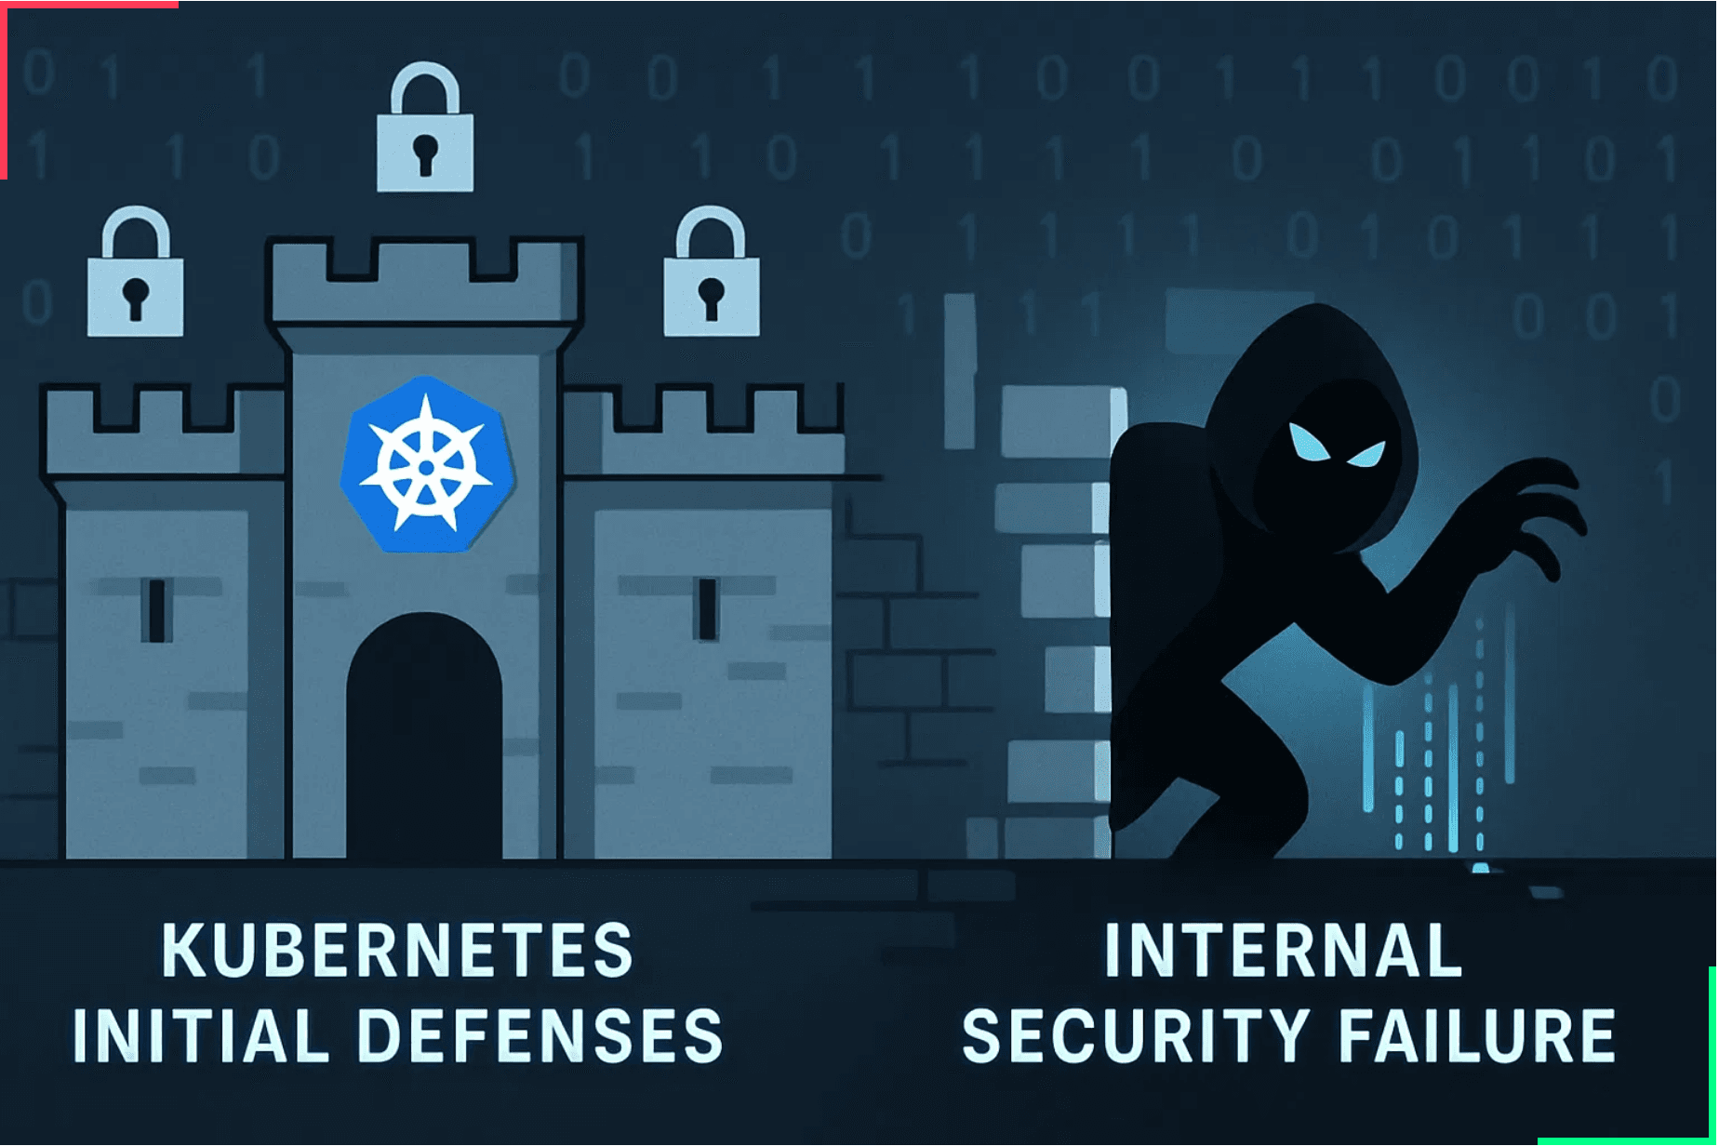
⚠ SECURITY GAP DETECTED
The Runtime Security Problem
Perimeter defenses don't protect against internal threats during execution. Traditional Kubernetes security measures focus on access control and initial configuration, but fail to detect malicious behaviors after deployment.
KEY RUNTIME VULNERABILITIES:
Execution of unauthorized commands inside containers
▸
Access to sensitive system files
▸
Suspicious or unexpected network connections
▸
Privilege escalation and configuration modifications
▸
Malicious activities that go undetected
▸
$ threat_analysis --mode=runtime
SLIDE 02/12

Slide 4

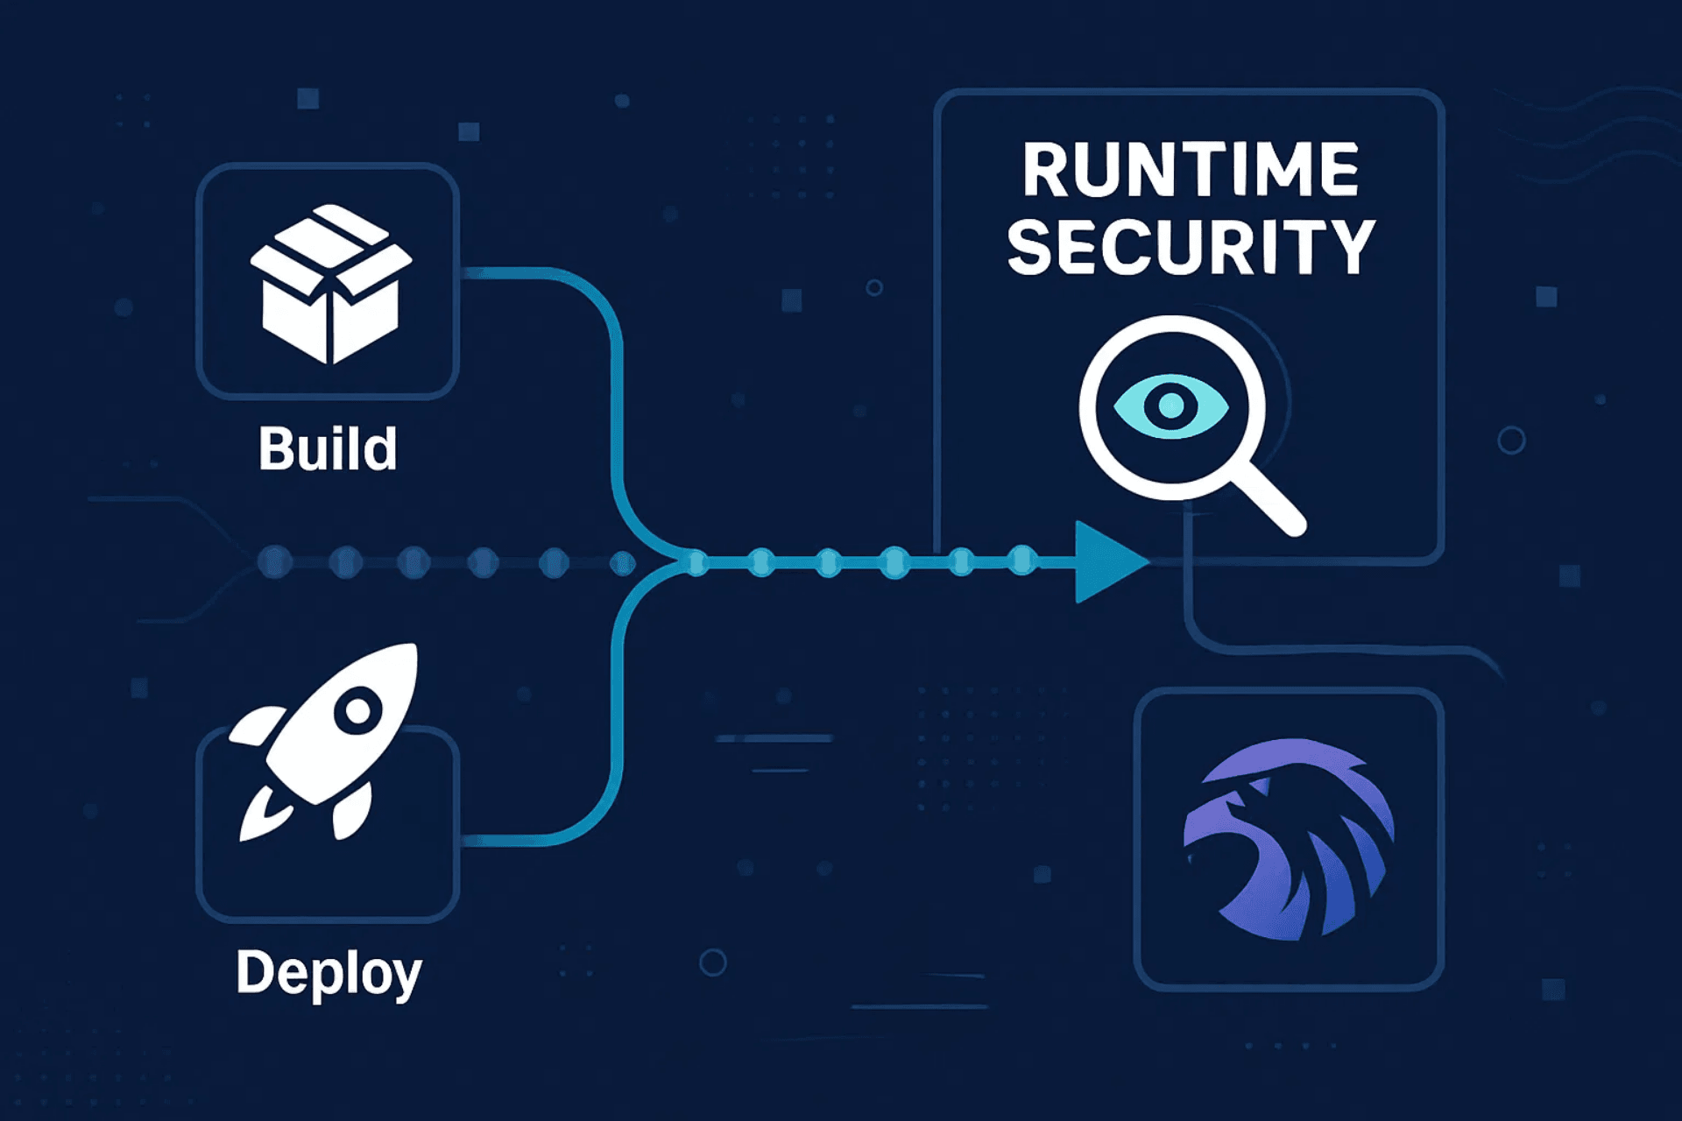
🔐 CKS CERTIFICATION
Runtime Security in CKS Context
Runtime security complements build and deploy practices. The Certified Kubernetes Security Specialist (CKS) exam recognizes that security doesn't end at deployment. While DevSecOps practices protect the development pipeline, Runtime Security monitors the actual behavior of workloads in production.
BUILD / DEPLOY → STATIC SECURITY
RUNTIME → DYNAMIC SECURITY
Image analysis, admission policies, RBAC, network configuration and access controls applied before execution
Syscall monitoring, anomalous behavior detection, real-time alerts about active threats
$ security_pipeline --phase=runtime
SLIDE 03/12

Slide 5


🦅 CNCF GRADUATED PROJECT
What is Falco?
Open-source CNCF tool for real-time threat detection. Falco is a graduated Cloud Native Computing Foundation project that acts as an intrusion detection system for Kubernetes and Linux environments. It monitors system calls (syscalls) at the kernel level, applying customizable rules to identify suspicious or malicious behaviors instantly.
KEY FEATURES:
Continuous monitoring of Linux kernel events
✓
Detection based on flexible and customizable rules
✓
Native integration with cloud-native ecosystem
✓
Real-time alerts for immediate response
✓
Zero impact on application performance
✓
$ falco --about | status: active
SLIDE 04/12

Slide 6

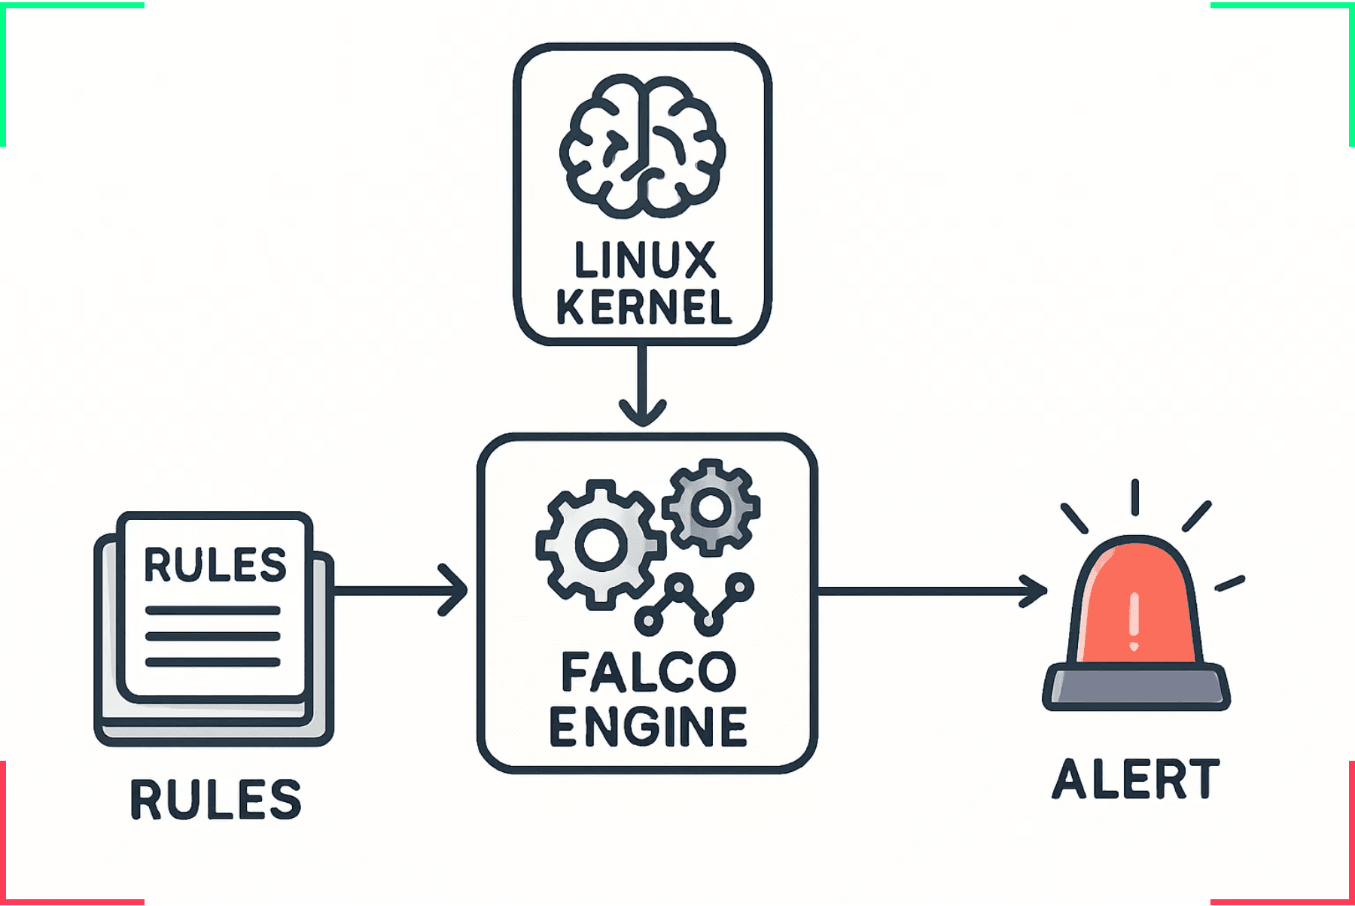
⚙ SYSTEM ARCHITECTURE
Falco Architecture and Operation
Kernel monitoring with rule-based detection. Falco operates in three integrated layers: event capture from the kernel through drivers, processing by the Falco Engine that applies detection rules, and alert generation when suspicious behaviors are identified.
01
02
03
LINUX KERNEL
FALCO ENGINE
ALERT SYSTEM
Captures syscalls and operating system events
Processes events and applies security rules
Real-time notifications about detected threats
$ falco --architecture-overview
SLIDE 05/12

Slide 7


⚙ RULE CONFIGURATION
Falco Rules System
Customizable rules define suspicious behavior. Falco rules are written in a declarative syntax that specifies alert conditions, priorities, and actions, enabling precise detection of threats specific to the organization's context.
RULE COMPONENTS:
🔍 CONDITION
Logic that defines when to alert (e.g., access to /etc/shadow)
📝 OUTPUT
Formatted message with event context
⚠ PRIORITY
Severity level (Emergency, Alert, Critical, Warning, Info)
🏷 TAGS
Categorization for analysis and filtering
EXAMPLE: Detect shell execution in production container or unauthorized access to sensitive system files
$ falco --rules-file custom_rules.yaml
SLIDE 06/12

Slide 8

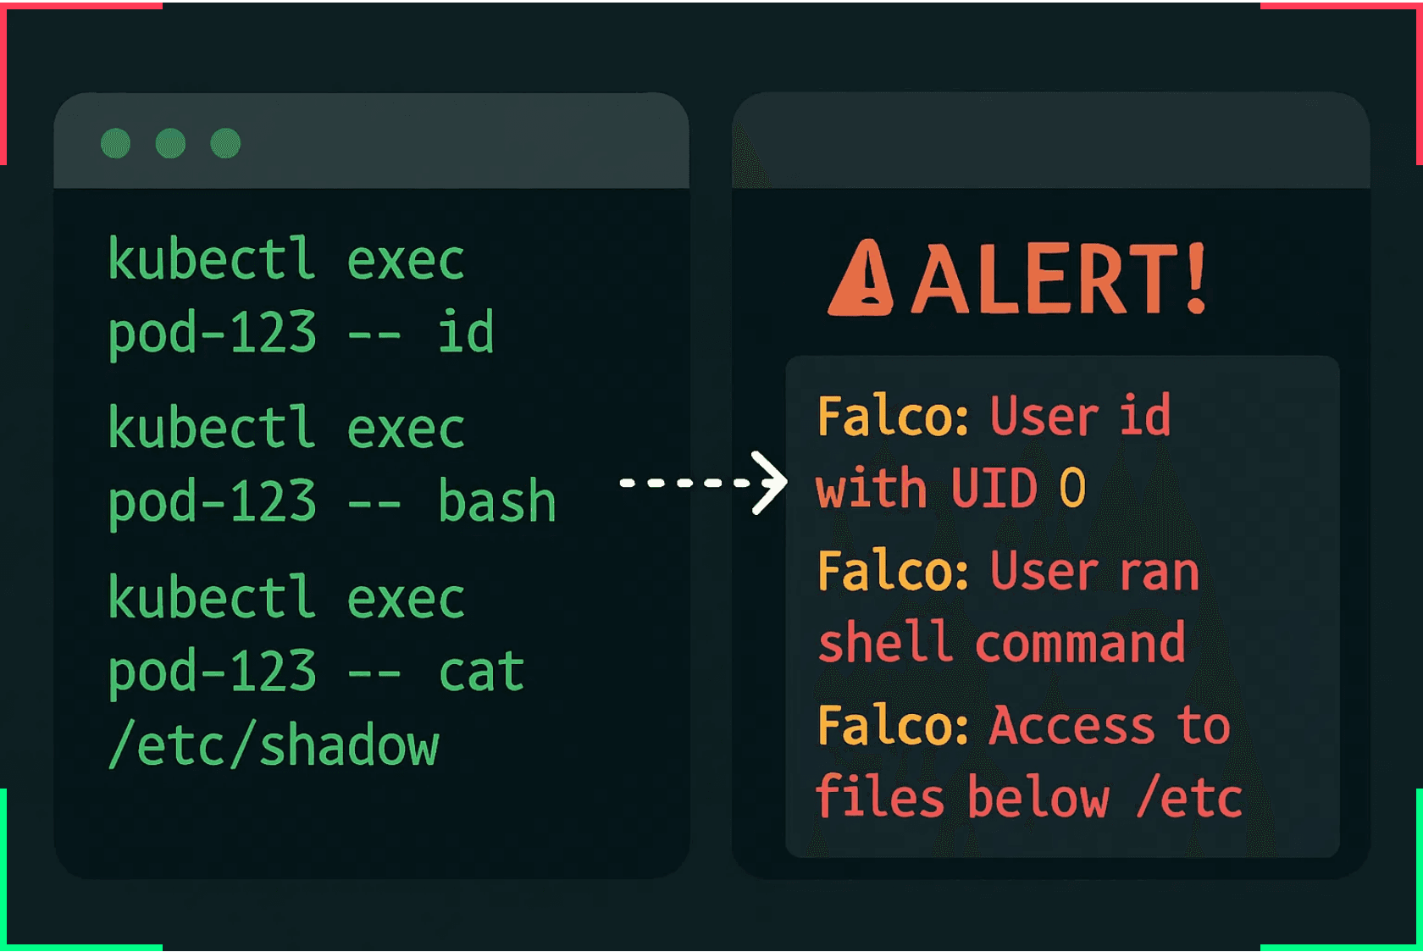
🔴 LIVE DEMO
Demo: Real-Time Attack Detection
Falco instantly identifies malicious commands executed in containers. When an attacker attempts to execute an interactive shell using kubectl exec, Falco detects the corresponding syscall and generates a detailed alert in milliseconds.
ATTACK SCENARIO:
⚠ FALCO ALERT:
$ kubectl exec -it vulnerable-pod -- /bin/bash
Warning: Shell spawned in container (user=root container_id=abc123 image=nginx:latest)
$ falco --demo --realtime-detection
SLIDE 07/12

Slide 9


🔒 CKS SCENARIO #1
Sensitive File Protection
🔍 MONITORING ACTIVE
One of the CKS exam requirements is protecting sensitive files like /etc/shadow, TLS certificates, and service tokens. Falco monitors all read or modification attempts on these files, alerting immediately when unauthorized processes try to access them.
RULE EXAMPLE:
Detect reading of /etc/shadow by processes other than authorized system tools
✓ BENEFIT
Prevention of credential theft and privilege escalation through active protection of sensitive system files.
$ falco --rule=file_protection --monitor=/etc/shadow
SLIDE 08/12

Slide 10

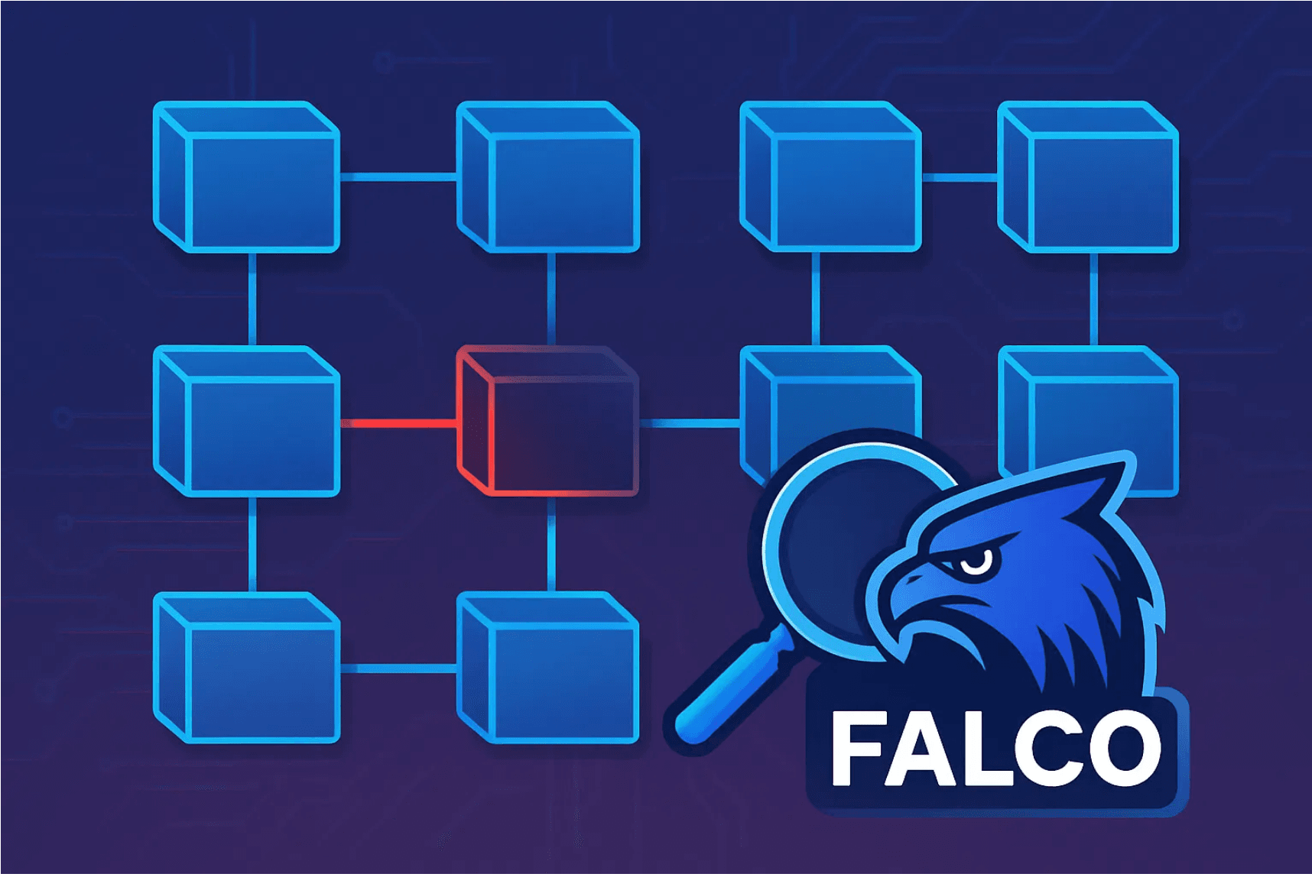
⚡ CKS SCENARIO #2
Suspicious Network Monitoring
Falco detects anomalous communication patterns, such as connections to suspicious external IPs, unauthorized ports, or unexpected protocols. This is essential for identifying data exfiltration, command-and-control server communication, or cryptocurrency mining.
⚠ THREAT DETECTED
DETECTION EXAMPLES:
Container making external SSH connection
Traffic to undocumented ports
Communication with blocklisted IPs
Unexpected protocols for application type
✓ RESPONSE
Alerts enable rapid isolation of compromised container before sensitive data is exfiltrated.
$ falco --rule=network_anomaly --monitor=connections
SLIDE 09/12

Slide 11

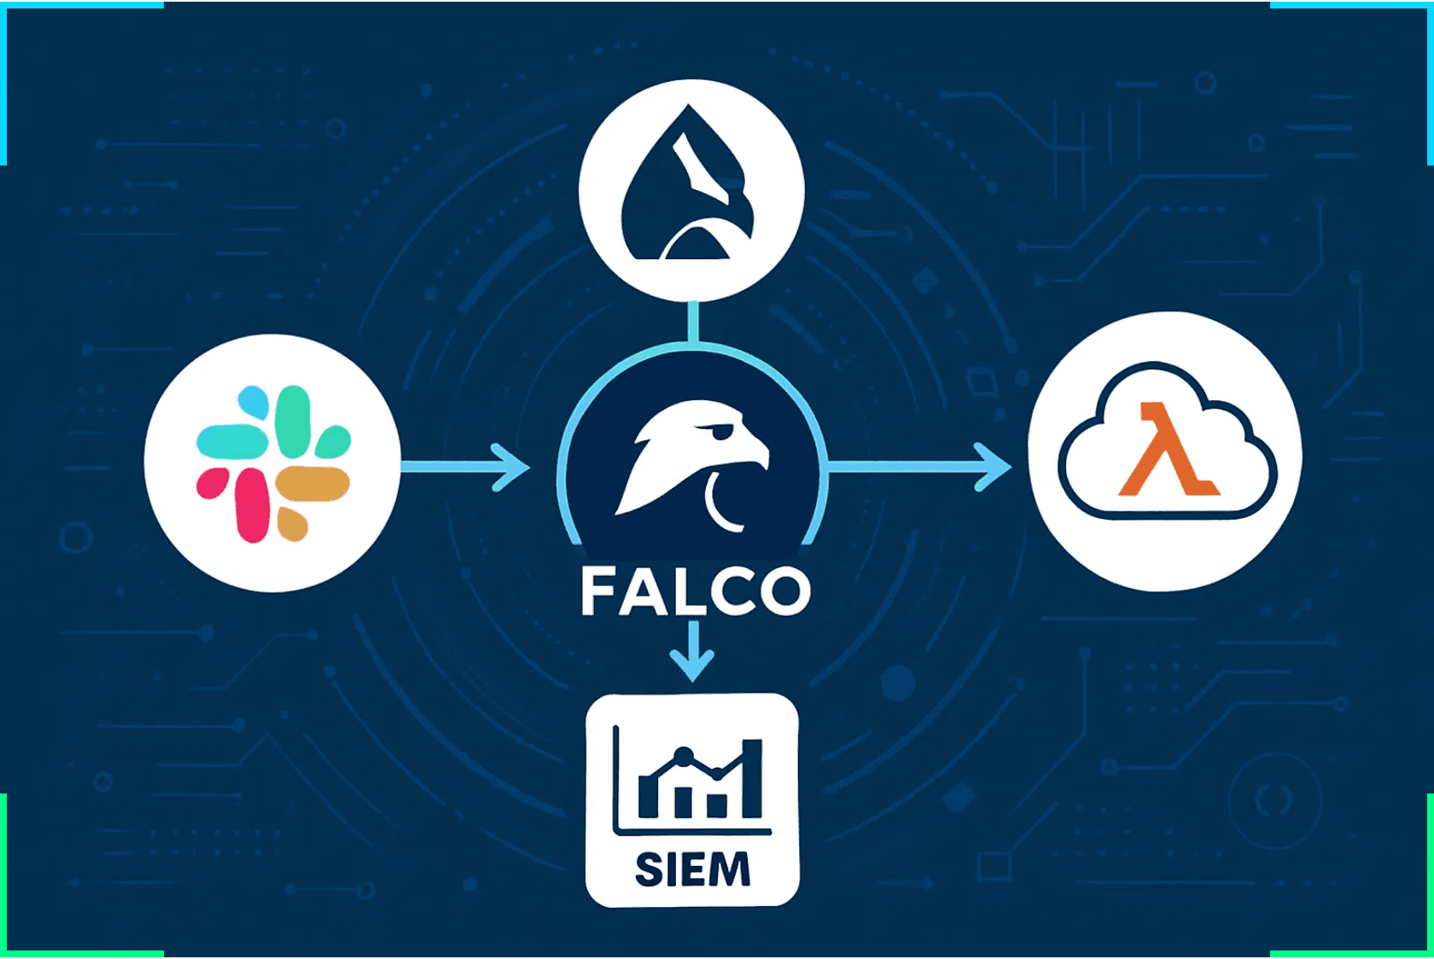
🔗 ECOSYSTEM INTEGRATION
Security Ecosystem Integration
Falco integrates with response and analysis tools. Alerts can be sent to multiple destinations, enabling incident response automation and centralized security event analysis.
💬 SLACK/TEAMS
📊 SIEM
⚡ LAMBDA
📈 METRICS
Immediate notifications for security teams
Centralized analysis and event correlation
Automated response (isolate pod, block IP)
Security metrics and dashboards
REAL-TIME DETECTION + AUTOMATED RESPONSE = REDUCED CONTAINMENT TIME
$ falco --integrations --list-all
SLIDE 10/12

Slide 12


→ NEXT STEPS
Next Steps
Implementation and deepening in Falco
RECOMMENDED RESOURCES:
📘Official documentation:falco.org
⚡ IMMEDIATE ACTION
Install Falco in a test cluster and experiment with default rules before customizing for production.
💻GitHub repository:github.com/falcosecurity/falco
$ helm install falco falcosecurity/falco
📋Community rules:github.com/falcosecurity/rules
🎓CKS tutorials:kubernetes.io/docs/tasks/administer-cluster
$ falco --get-started
SLIDE 11/12

Slide 13


? Q&A SESSION
Questions and Discussion
Thank you for your attention!
I'm available to answer questions about Falco and Runtime Security
IMPLEMENTATION
USE CASES
INTEGRATION
CKS PREPARATION
READY FOR QUESTIONS
$ session --status=complete --mode=interactive
SLIDE 12/12

